Slide 1
8237DMA CONTROLLER

Slide 2
Introduction:
Direct Memory Access (DMA) is a method of allowing data to be moved from one location to another in a computer without intervention from the central processor (CPU).
It is also a fast way of transferring data within (and sometimes between) computer.
The DMA I/O technique provides direct access to the memory while the microprocessor is temporarily disabled.
The DMA controller temporarily borrows the address bus, data bus and control bus from the microprocessor and transfers the data directly from the external devices to a series of memory locations (and vice versa).

Slide 3
Basic DMA Operation:
Two control signals are used to request and acknowledge a direct memory access (DMA) transfer in the microprocessor-based system.
The HOLD signal as an input(to the processor) is used to request a DMA action.
The HLDA signal as an output that acknowledges the DMA action.
When the processor recognizes the hold, it stops its execution and enters hold cycles.

Slide 4
Cont.,
HOLD input has higher priority than INTR or NMI.
The only microprocessor pin that has a higher priority than a HOLD is the RESET pin.
HLDA becomes active to indicate that the processor has placed its buses at high-impedance state.

Slide 5
Basic DMA Definitions:
Direct memory accesses normally occur between an I/O device and memory without the use of the microprocessor.
A DMA read transfers data from the memory to the I/O device.
A DMA write transfers data from an I/O device to memory.
The system contains separate memory and I/O control signals.
Hence the Memory & the I/O are controlled simultaneously

Slide 6
The DMA controller provides memory with its address, and the controller signal selects the I/O device during the transfer.
Data transfer speed is determined by speed of the memory device or a DMA controller.
In many cases, the DMA controller slows the speed of the system when transfers occur.
The serial PCI (Peripheral Component Interface) Express bus transfers data at rates exceeding DMA transfers.
This in modern systems has made DMA is less important.

Slide 7
The 8237 DMA Controller
The 8237 supplies memory & I/O with control signals and memory address information during the DMA transfer.
It is actually a special-purpose microprocessor whose job is high-speed data transfer between memory and I/O

Slide 8
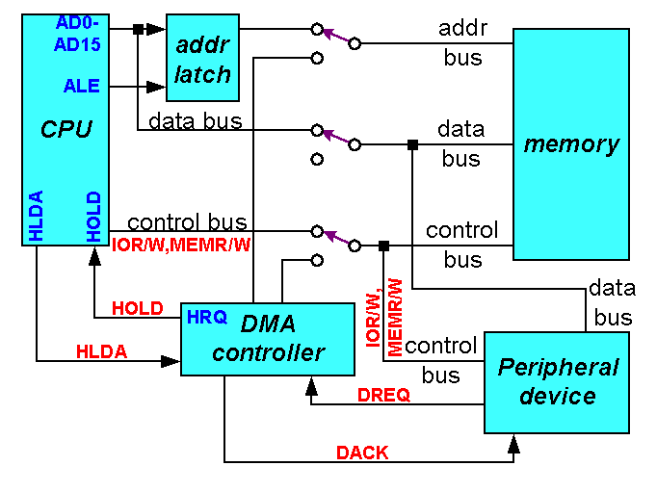
CPU having the control over the bus:

Slide 9

When DMA operates:

Slide 10
8237 is not a discrete component in modern microprocessor-based systems.
It appears within many system controller chip sets
8237 is a four-channel device compatible with 8086/8088, adequate for small systems.
Expandable to any number of DMA channel inputs
8237 is capable of DMA transfers at rates up to 1.6MB per second.
Each channel is capable of addressing a full 64K-byte section of memory.

Slide 11
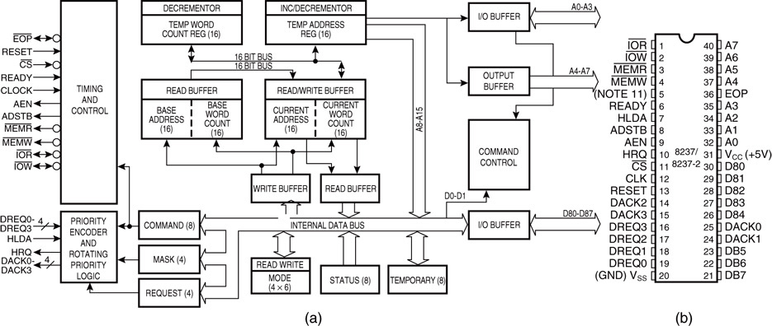
Programmable DMA controller. (a) Block diagram and (b) pin-out.

Slide 12
8237 Internal Registers
CAR
The current address register holds a 16-bit memory address used for the DMA transfer.
Each channel has its own current address register for this purpose.
When a byte of data is transferred during a DMA operation, CAR is either incremented or decremented depending on how it is programmed.

Slide 13
CWCR
The current word count register programs a channel for the number of bytes to transferred during a DMA action.
CR
The command register programs the operation of the 8237 DMA controller.
The register uses bit position 0 to select the memory-to-memory DMA transfer mode.
Memory-to-memory DMA transfers use DMA channel 0 to hold the source address
DMA channel 1 holds the destination address

Slide 14
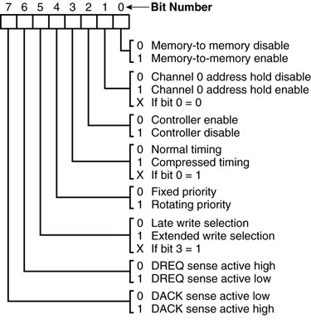
command register.

Slide 15
BA and BWC
The base address (BA) and base word count (BWC) registers are used when auto-initialization is selected for a channel.
In auto-initialization mode, these registers are used to reload the CAR and CWCR after the DMA action is completed.

Slide 16
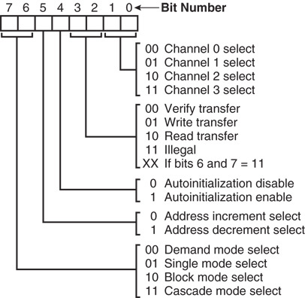
MR
The mode register programs the mode of operation for a channel.
Each channel has its own mode register as selected by bit positions 1 and 0.
Remaining bits of the mode register select operation, auto-initialization, increment/decrement, and mode for the channel

Slide 17
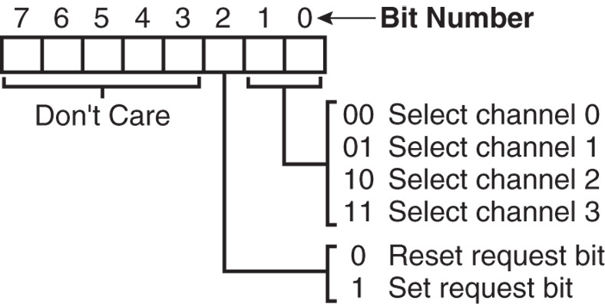
BR
The bus request register is used to request a DMA transfer via software.
very useful in memory-to-memory transfers, where an external signal is not available to begin the DMA transfer

Slide 18
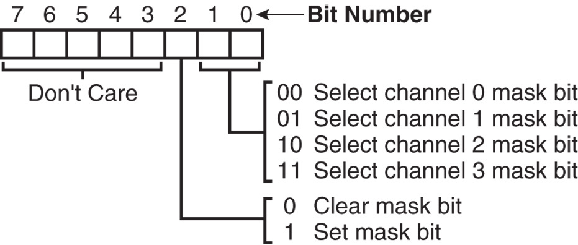
MRSR
The mask register set/reset sets or clears the channel mask.
if the mask is set, the channel is disabled
the RESET signal sets all channel masks to disable them

Slide 19
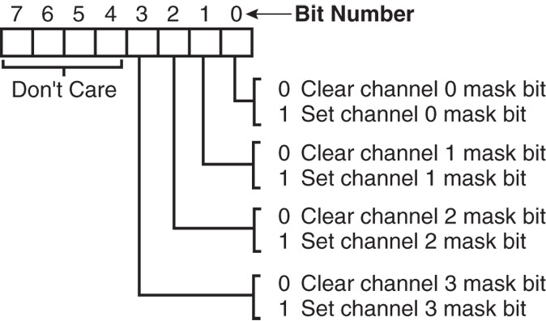
MSR
The mask register clears or sets all of the masks with one command instead of individual channels, as with the MRSR.

Slide 20
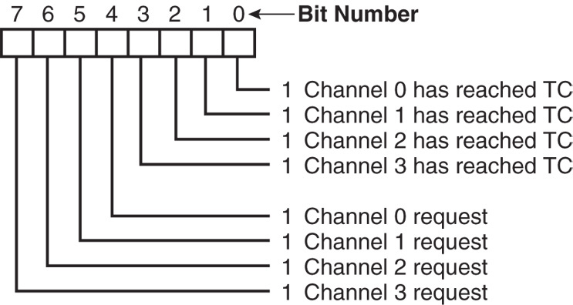
SR
The status register shows status of each DMA channel. The TC bits indicate if the channel has reached its terminal count (transferred all its bytes).
When the terminal count is reached, the DMA transfer is terminated for most modes of operation.
The request bits indicate whether
the DREQ input for a given channel is active.

Slide 21
Master clear
Acts exactly the same as the RESET signal to the 8237.
As with the RESET signal, this command disables all channels
Clear mask register
Enables all four DMA channels.
Clear the first/last flip-flop
Clears the first/last (F/L) flip-flop within 8237.
The F/L flip-flop selects which byte (low or high order) is read/written in the current address and current count registers.
if F/L = 0, the low-order byte is selected
if F/L = 1, the high-order byte is selected
Any read or write to the address or count register automatically toggles the F/L flip-flop.

Slide 22
Memory-to-Memory Transfer with the 8237 :
Memory-to-memory transfer is much more powerful than the automatically repeated MOVSB instruction.
most modern chip sets do not support the memory-to-memory feature
8237 requires only 2.0 µs per byte, which is over twice as fast the existing data transfer.

